Slide 1


WP3 Data Quality Assurance
By Punit Gupta

Slide 2

Index
Objective
Deliverables
Data Quality Workflow
Data Quality
Survey
EO Data type
Steps

Slide 3
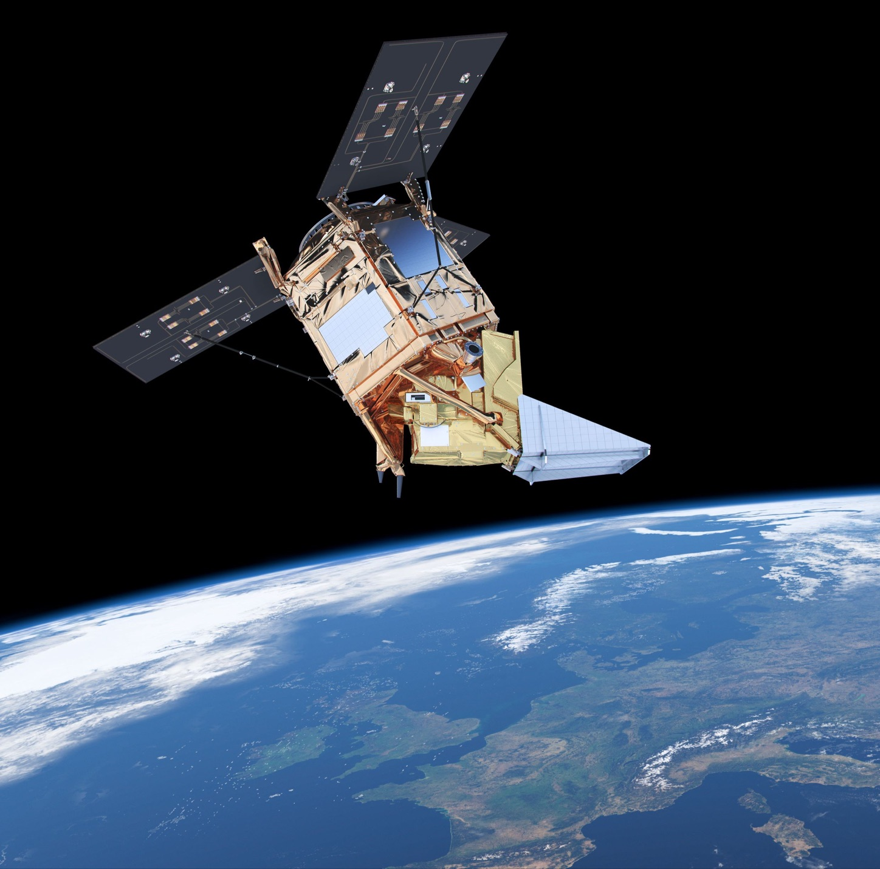

Objectives
Design and formulation of mechanisms for the adjudication of data quality;
Use of discovery services to identify temporally and geographically adjacent data sources;
Provision of services for ground truthing data with relevant (location and temporal adjacency) and known high-quality data sets;
Design and implementation of trusted mechanisms to filter ‘poor-quality data’ and ensure non-admittance to the data warehouse
Design and formulation of mechanisms for the adjudication of data quality;
Use of discovery services to identify temporally and geographically adjacent data sources;
Provision of services for ground truthing data with relevant (location and temporal adjacency) and known high-quality data sets;
Design and implementation of trusted mechanisms to filter ‘poor-quality data’ and ensure non-admittance to the data warehouse

Slide 4
Deliverables
D3.1 Design of Data Quality Adjudication Framework (M19)
D3.2 Design and Implementation of Data Quality Filter (M24)
Milestone
MS3.1 Delivery of Data Quality Filter (M24)

Slide 5
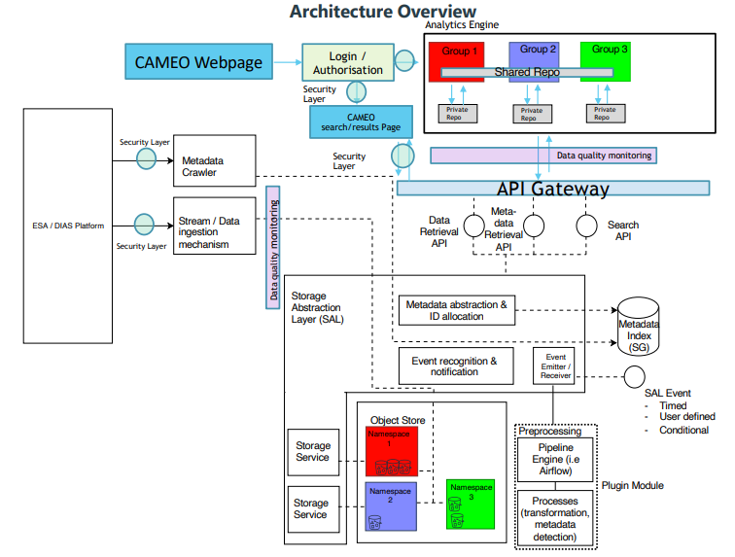
CAMEO Workflow

Slide 6
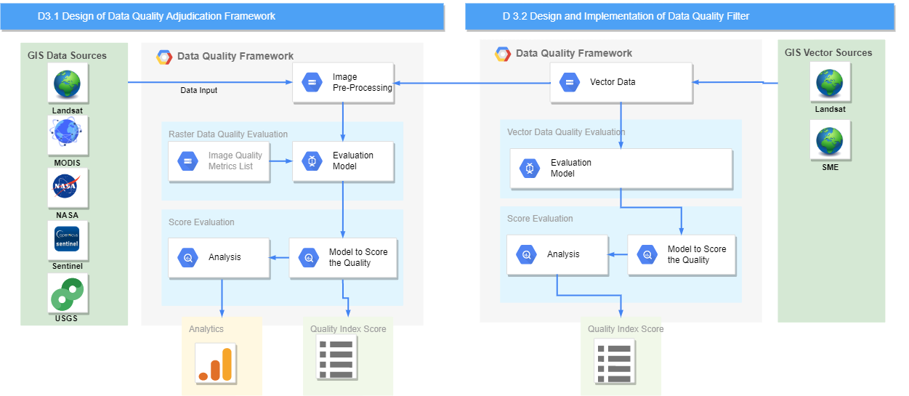
Data Quality Workflow

Slide 7
Data Quality
Data Quality metrics
•Data Precision or resolution
•Data Completeness
•Data Accuracy
•Data Consistency
•Data Timelines
EO Data Quality Assurance
• Visibility (Cloud Cover, Haze, Fog)
• Image Quality
• Data Assurance Index

Slide 8
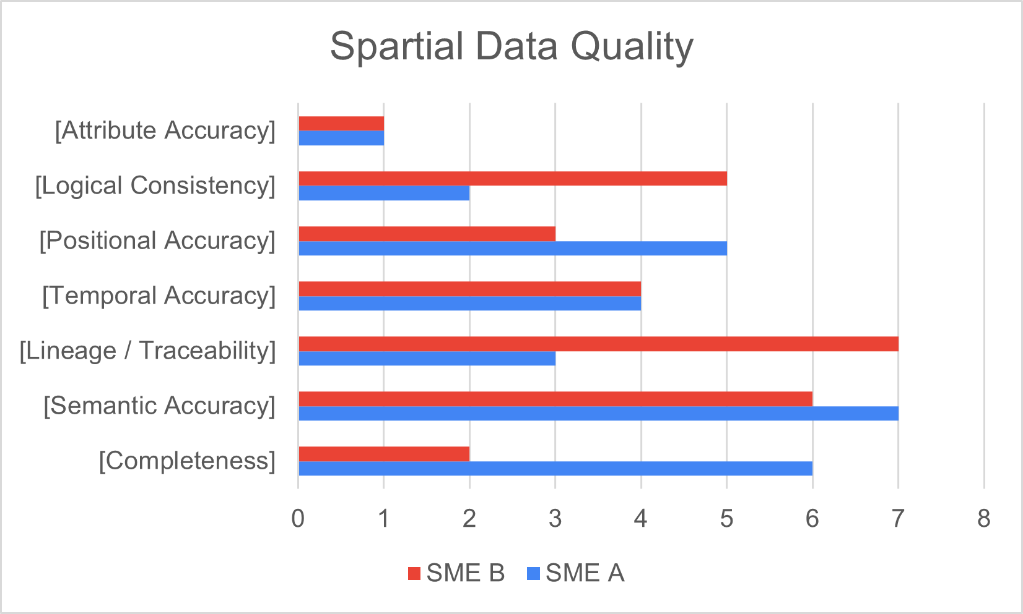
Survey
Importance of Data Quality for SME

Slide 9
EO Data Types
Data Quality metrics
•Raster data
Satellite Images
Satellite Bands
•Vector Data
Layers
Timeseries data
GIS Data
Vector data
Raster data

Slide 10
Steps Identified
Steps Identified for D3.1
Study of CAMEO framework
Identification of various earth observatory sources
Categorization of earth observatory data types
Identifying the need for Data Quality and its evaluation matrix
Implementation of EO raster data Quality matrix
Predictive analysis of usability for an SME
Steps Identified for D3.2
Study of Vector data quality metrics
Classification of various vector EO data and identification of suitable vector data quality metrics
Implementation of EO vector data quality matrix
Data filters for SME raster and vector data
Predictive analysis of the usability of vector data for an SME

Slide 11


Thank You

Slide 12
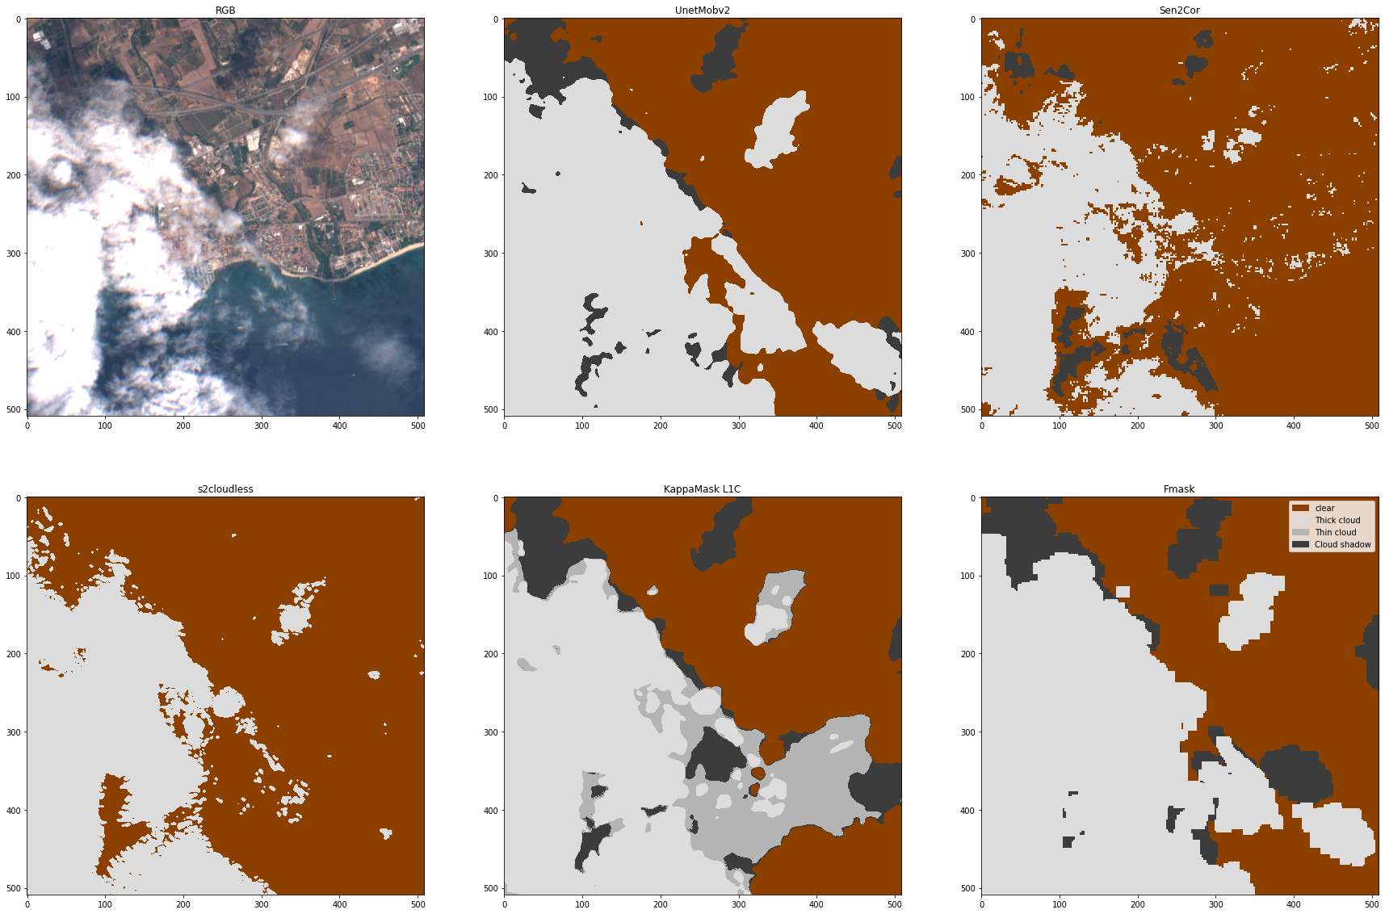
Visibility Index
Visibility index
Cloud detection algorithms
MSFCC
FMASK
RS-NET
SEN2COR
SENL1C
S2CLOUDLESS
Classification of visibility :
Clouds
Haze
Fog
Data Source
•Raster data
Landsat-8
Santenal-2

Slide 13
Data Assurance Index
Data Quality metrics
NDVI
NDMI
MSAVI
NDWI
SAVI
ARVI
SIPI
EVI
NBR
DEFORESTATION DETECTION
FIREDETECTION
NDRE
Water Index
Vegetation Index
Soil Index
Snow Index
Moisture Index
Precipitation Index
Ref: https://eos.com/make-an-analysis/index-stack/

